Slide 1

API Proxy Pattern:
Reusable and Mockable
API Calls
Allan A. Chua
https://www.pogsdotnet.com

Slide 2
GITHUB DEMO LINK
https://bit.ly/2HhiRVv

Slide 3
Slide Deck Link
https://bit.ly/2TH1mDM

Slide 4
Agenda
What is Proxy Design Pattern
Problems it solves
How to implement
How to improve
How it makes testing easy
The Future

Slide 5
What is Proxy Pattern
Provide a surrogate or placeholder for another object to control access to it.
Use an extra level of indirection to support distributed, controlled, or intelligent access.
Add a wrapper and delegation to protect the real component from undue complexity.

Slide 6
How it Looks Like
Object
Proxy
Consumer
Encapsulates access
management

Slide 7
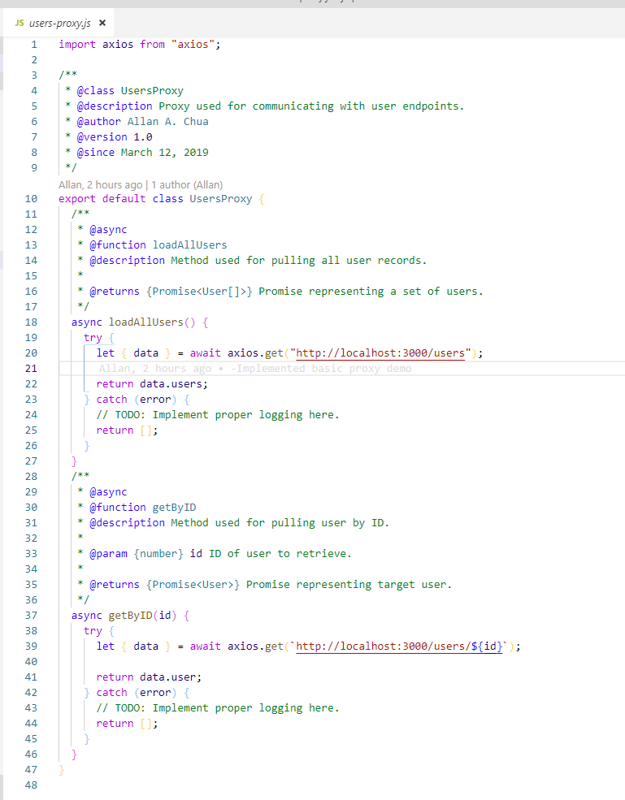
How it Looks Like

Slide 8
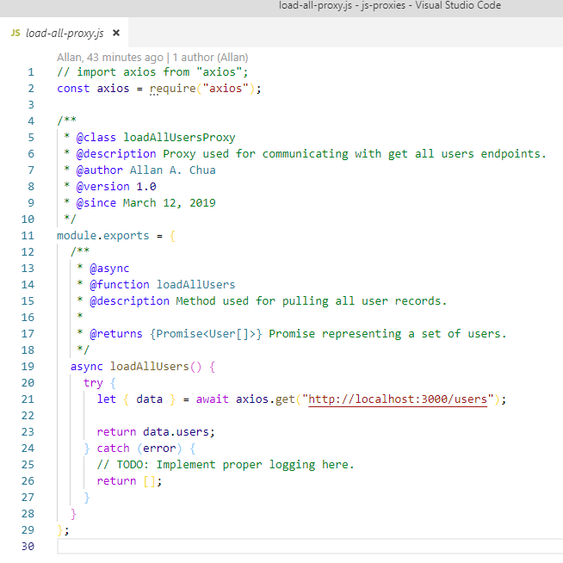
How it Looks Like

Slide 9
Why its perfect for API Calls
Consumer
API
Proxy
Encapsulates protocol and framework used to call API

Slide 10
Bad API Reuse
Consumer A
Consumer B
Consumer C
API A
API A
API B
API B
API B

Slide 11
Good API Reuse
Consumer A
Consumer B
Consumer C
Proxy A
Proxy B
API A
API B

Slide 12
Easy and Predictable Testing
Consumer Testing
Consumer A
Mock Proxy
Proxy A
API A

Slide 13
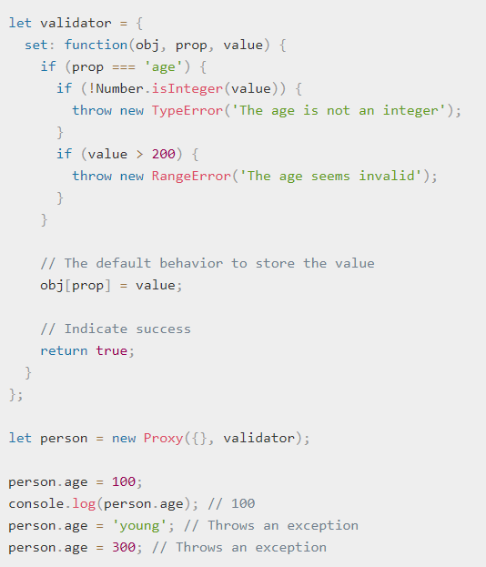
ES6 Proxies

Slide 14


